Slide 1
In silico design and property prediction of small molecules
Amanda Paulson, PhD
ATOM Internship Seminar Series
7/19/2022

Slide 2
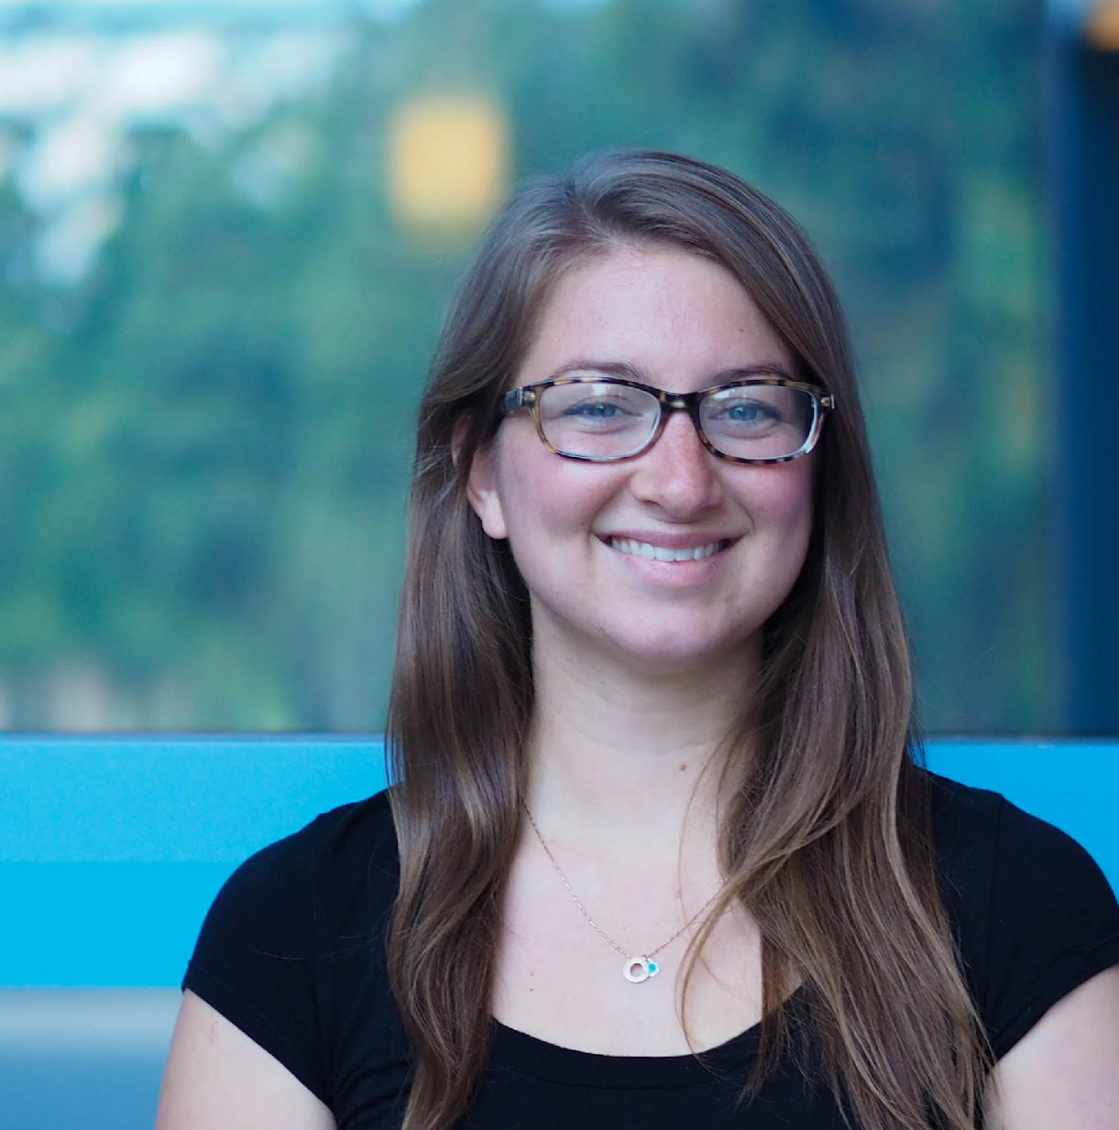
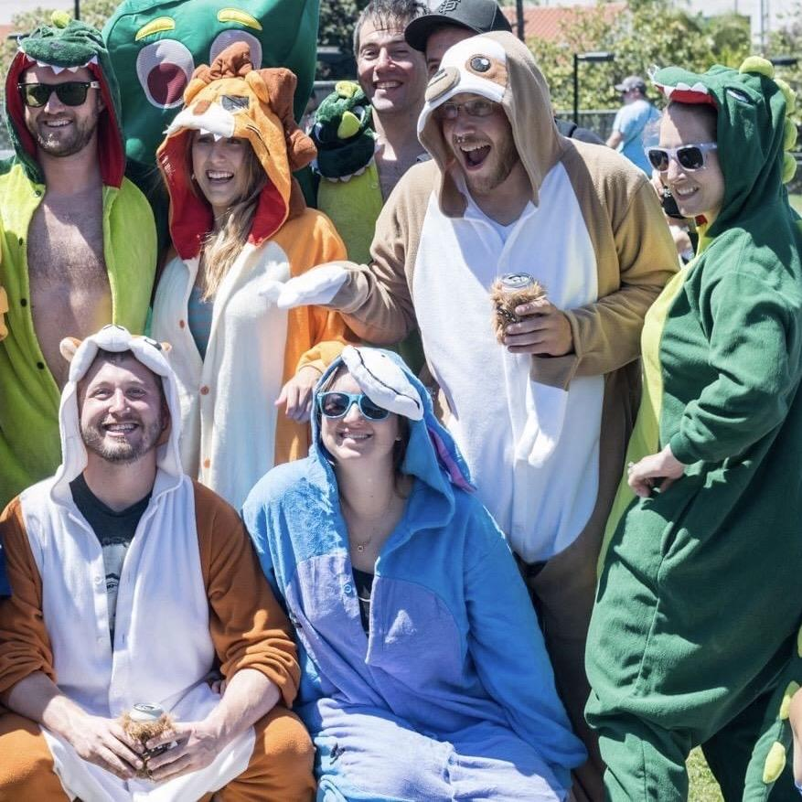
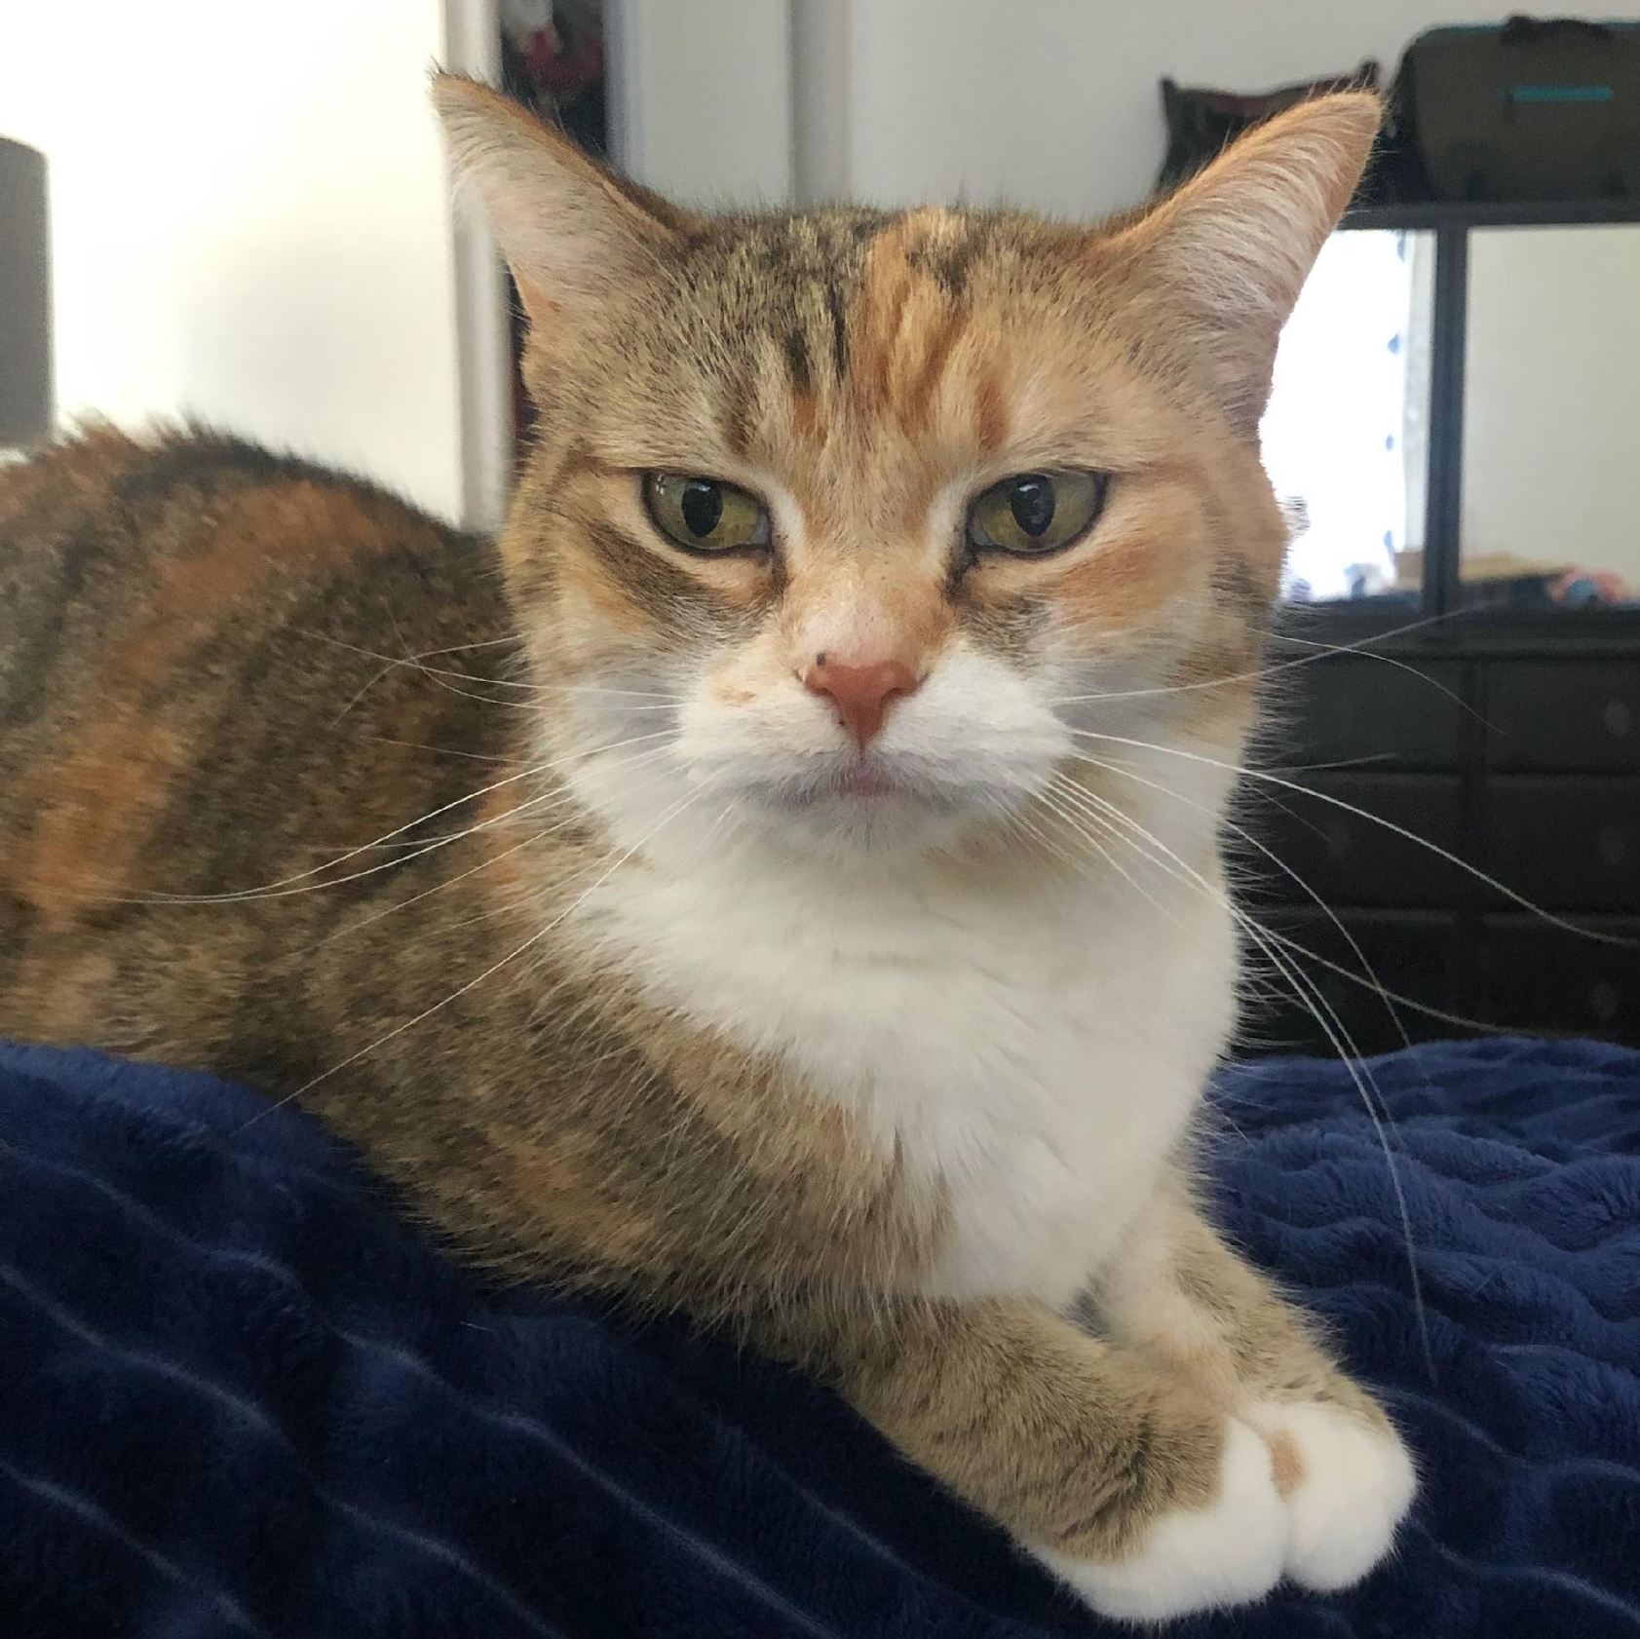
Amanda Paulson
My Experience
13 years at the bench doing cancer and cell biology research
ATOM fellowship working on data-driven models for drug-induced liver injury
Bio- and cheminformatics, machine learning, data visualization
Education
BS, Cell & Molecular Biology, University of Michigan
PhD, Biomedical Sciences, UCSF Gartner Lab
About Me
I grew up in a suburb of Detroit, MI
I like running, goofy costumes, craft beer, and sometimes combining those things
I read a ton of bad fiction for fun
I have a grumpy cat named Gato
Specialist in Informatics
amanda.paulson@ucsf.edu

Slide 3
Amanda Paulson, PhD ATOM Internship Seminar 2022
7/19/2022
In silico design and property prediction of small molecules
The ATOM platform is a comprehensive software package that includes modules for building data-driven QSAR models for predicting properties of molecules as well as generative models for molecular design. In this seminar we will discuss the workings of the GMD loop and view case studies for QSAR modeling. We discuss the applicability domain of models, data partitioning for model generalizability, and QBAR modeling for complex biological processes. Exploratory data analysis visualizations are presented for the model building process.

Slide 4
The ATOM platform

Slide 5
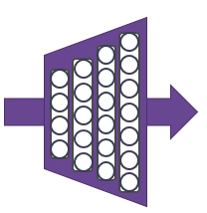
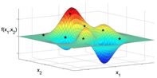
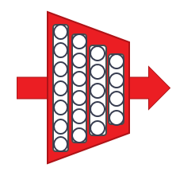


Property Prediction Pipeline
Efficacy
Safety
Working
Compound
Library
PK
Developability
Design Criteria
Generative Molecular Design
Prediction & Design Loop
proposes new molecules with optimized properties
Retrain property prediction models
Active learning
decides if/when a simulation or experiment is needed to improve or validate models
MD, docking, PBPK, PD/mechanistic models
Simulation Loop
Human-
Relevant
Assays
Chemistry Design & Synthesis
Experimental Loop
Notes:
We frame in silico drug design as a multi parameter optimization problem paired with active learning to improve and validate our predictors
Applying the platform to making molecules for work on cancer, infectious disease, and underserved needs in the public good
We’ve built out this platform over the last few years and have of course run into challenges

Slide 6
Challenges in in silico drug design

Slide 7
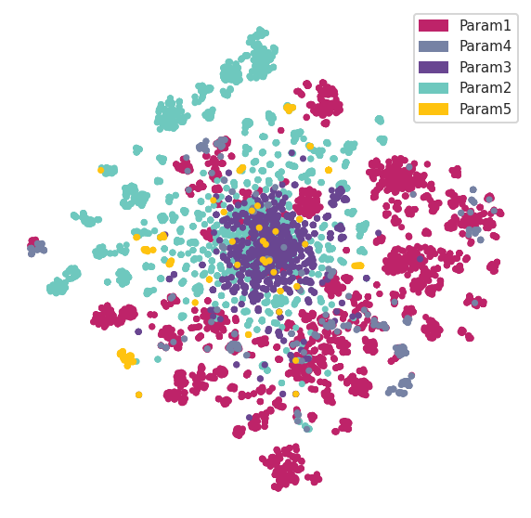
Data availability and domain of applicability
Generative design can push candidate compounds into new regions of chemical space
Any given parameter does not necessarily share training data with another parameter – especially with data from public sources
Training data can be highly heterogeneous w.r.t. experimental conditions & assay design
How can we take the domain of applicability into account when generating new molecules?
Notes:
During MPO you are often pushing into new regions of chemical space that may be far from your training data
Compounding this problem is the fact that any given parameter does not share the same training data as another parameter
Pulling data from public sources compounds this problem even further -

Slide 8
Application of the ATOM platform for in silico design

Slide 9
Property Prediction Pipeline
Efficacy
Safety
Working
Compound
Library
PK
Developability
Design Criteria
Generative Molecular Design
Prediction & Design Loop
proposes new molecules with optimized properties
Retrain property prediction models
Active learning
decides if/when a simulation or experiment is needed to improve or validate models
MD, docking, PBPK, PD/mechanistic models
Simulation Loop
Human-
Relevant
Assays
Chemistry Design & Synthesis
Experimental Loop

Slide 10
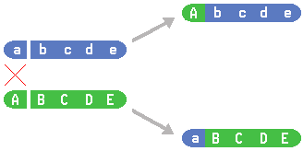
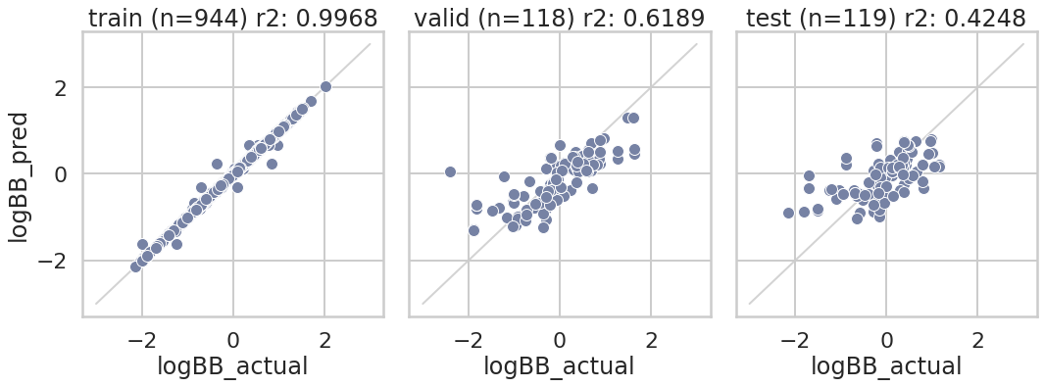
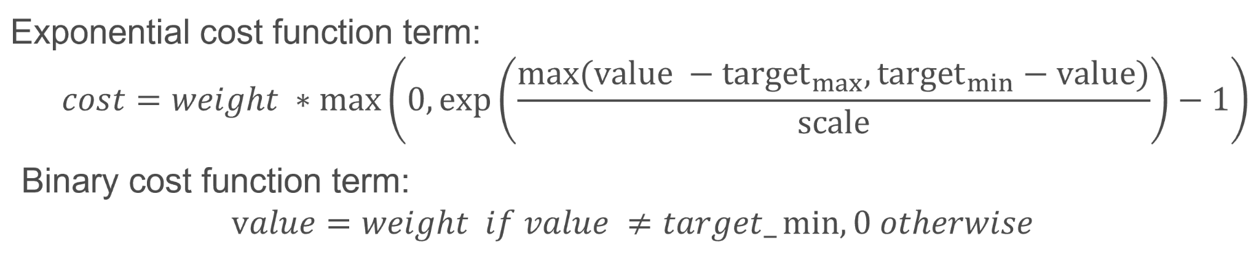
Generative molecular design (GMD)
A generative model for proposing new chemical structures, often involving a latent space representation.
JT-VAE w/
genetic
algorithm
Predictive models to infer the properties of compounds given their structures. Can use either mechanistic or machine learning (ML) approaches.
An optimizer to guide the generative model to produce molecules with favorable predicted properties.
Slides courtesy of Kevin McLoughlin

Slide 11
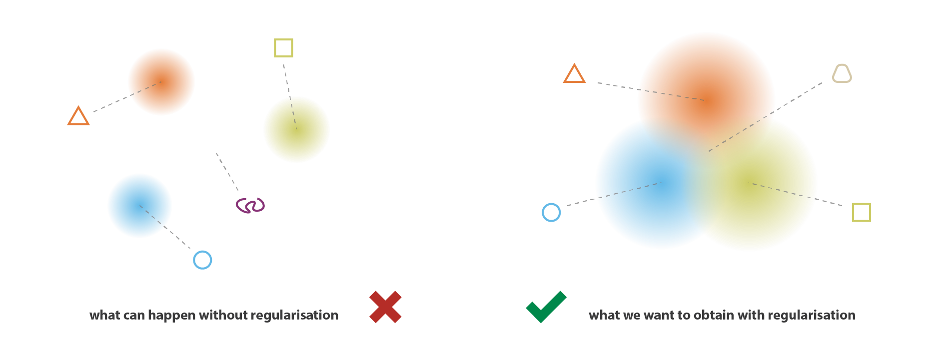
Latent space encoding
https://towardsdatascience.com/understanding-variational-autoencoders-vaes-f70510919f73

Slide 12
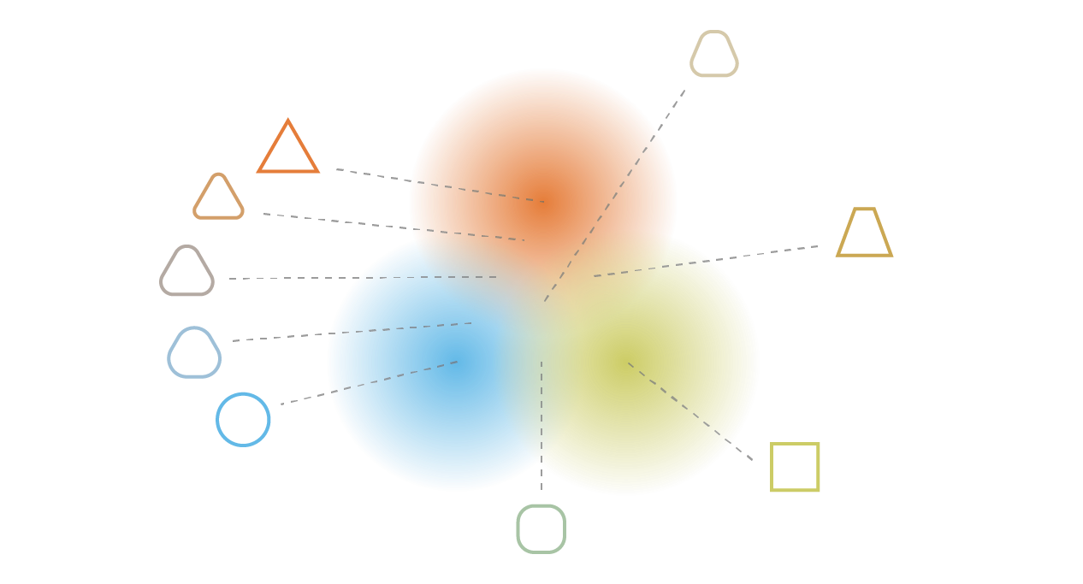
Sampling & decoding from latent space
https://towardsdatascience.com/understanding-variational-autoencoders-vaes-f70510919f73
Notes:
Input data will affect what comes out

Slide 13
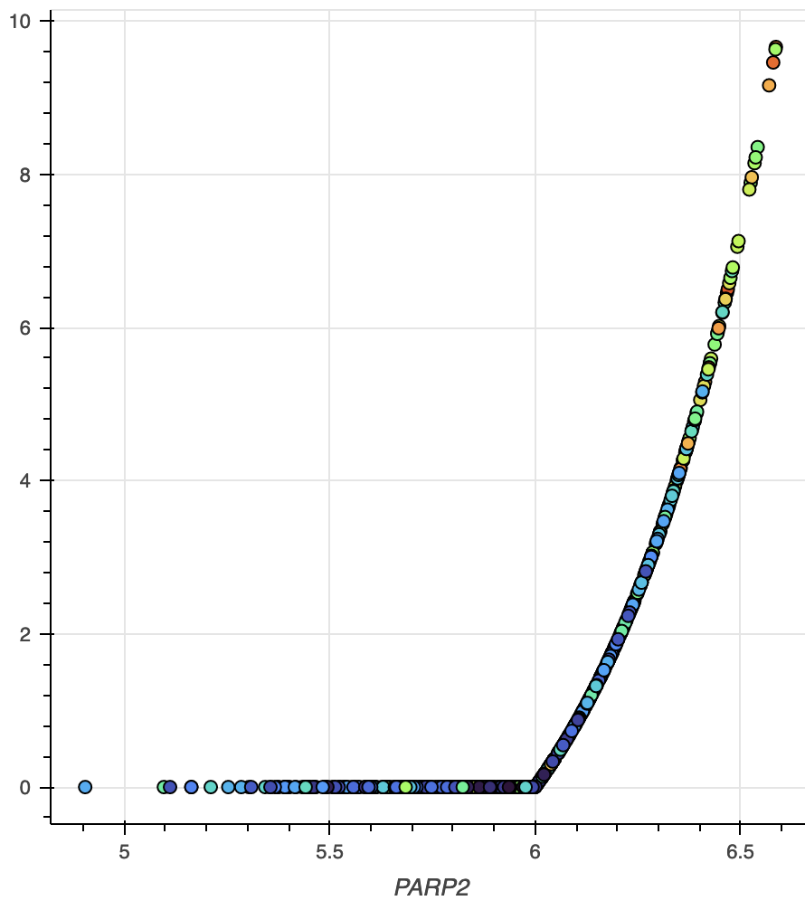
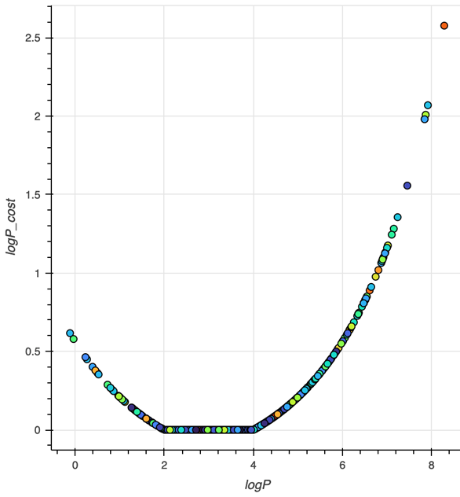
GMD Cost Function Design
Scoring (cost) function is a weighted sum of terms for each criterion; the GMD optimization tries to minimize this function.
pIC50
Off-target pIC50 cost term
Criterion: pIC50 < 6
logP (lipophilicity) cost term
Criterion: 2 < logP < 4
Slides courtesy of Kevin McLoughlin
Notes:
Terms are usually functions that are zero within the desired range of a parameter, and increase exponentially as the parameter goes outside the range.
The target range may be bounded on one or both sides.
Some parameters, such as the target potency value, may be allowed to contribute negative values to the cost.

Slide 14
Example cost function terms
Description | CostFunction | Target_min | Target_max | Weight | Scale | Allow_neg
On-target 1 pIC50 | exp | 8 |  | 3 | 0.72 | TRUE
Off-target 2 pIC50 | exp |  | 6 | 3 | 0.41 | FALSE
log brain/blood ratio | exp | 0.3 |  | 2 | 0.44 | FALSE
is p-GP substrate | binary | 0 |  | 1 | 0.46 | FALSE
is BCRP substrate | binary | 0 |  | 1 | 0.36 | FALSE
Total polar surface area | exp |  | 90 | 0.5 | 25.54 | FALSE
Synthetic accessibility score | exp |  | 3 | 0.5 | 0.90 | FALSE
Number of rotatable bonds | exp |  | 4 | 0.3 | 2.47 | FALSE
pKa (acidity coefficient) | exp | 6 | 10.5 | 0.3 | 3.13 | FALSE
Number of H-bond donors | exp |  | 3 | 0.5 | 1.19 | FALSE
Molecular weight | exp | 180 | 450 | 0.5 | 88.45 | FALSE
logP (lipophilicity) | exp | 2 | 4 | 0.3 | 1.90 | FALSE
Slides courtesy of Kevin McLoughlin
Notes:
Explain each column heading
Point out the other criteria besides the main models
Remove off-target 2?

Slide 15
GMD optimizer
Simplest: rank lowest-cost compounds and keep the top X to move forward with
New: tournament style; randomly group previous generation + current generation and select lowest cost per group. This increases compound diversity

Slide 16
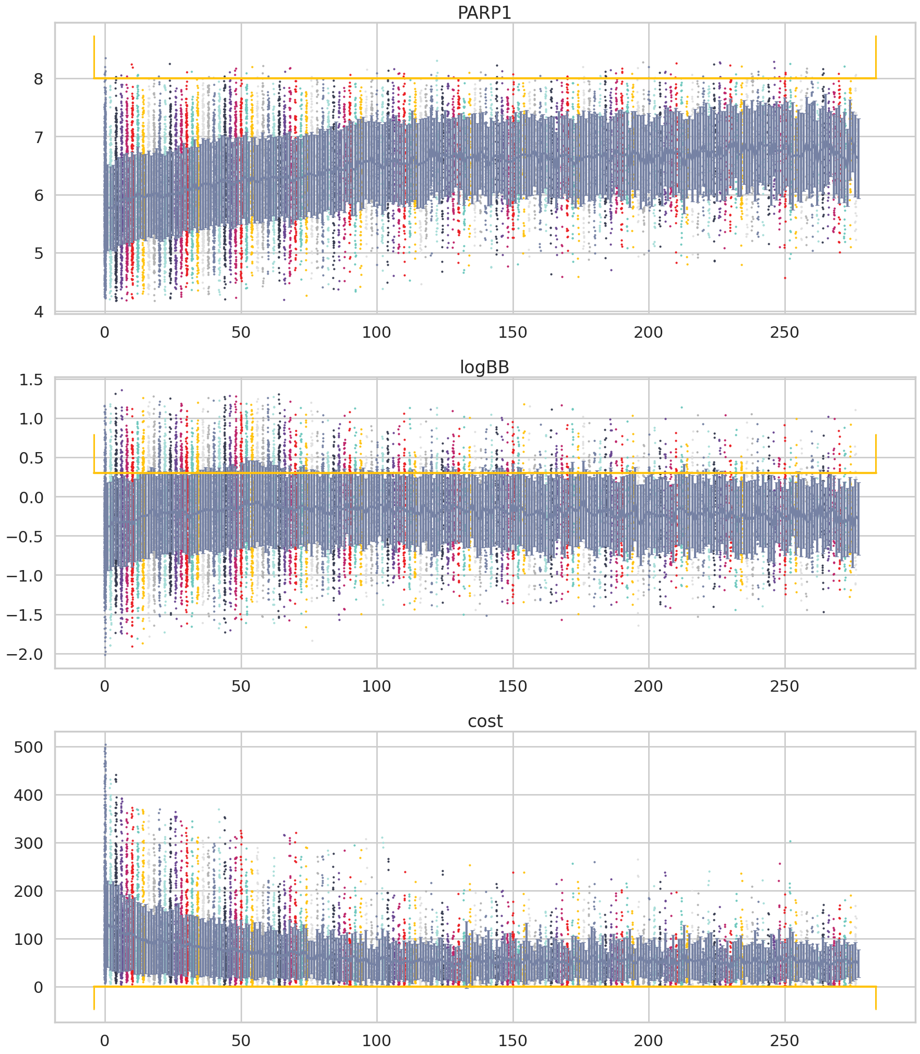
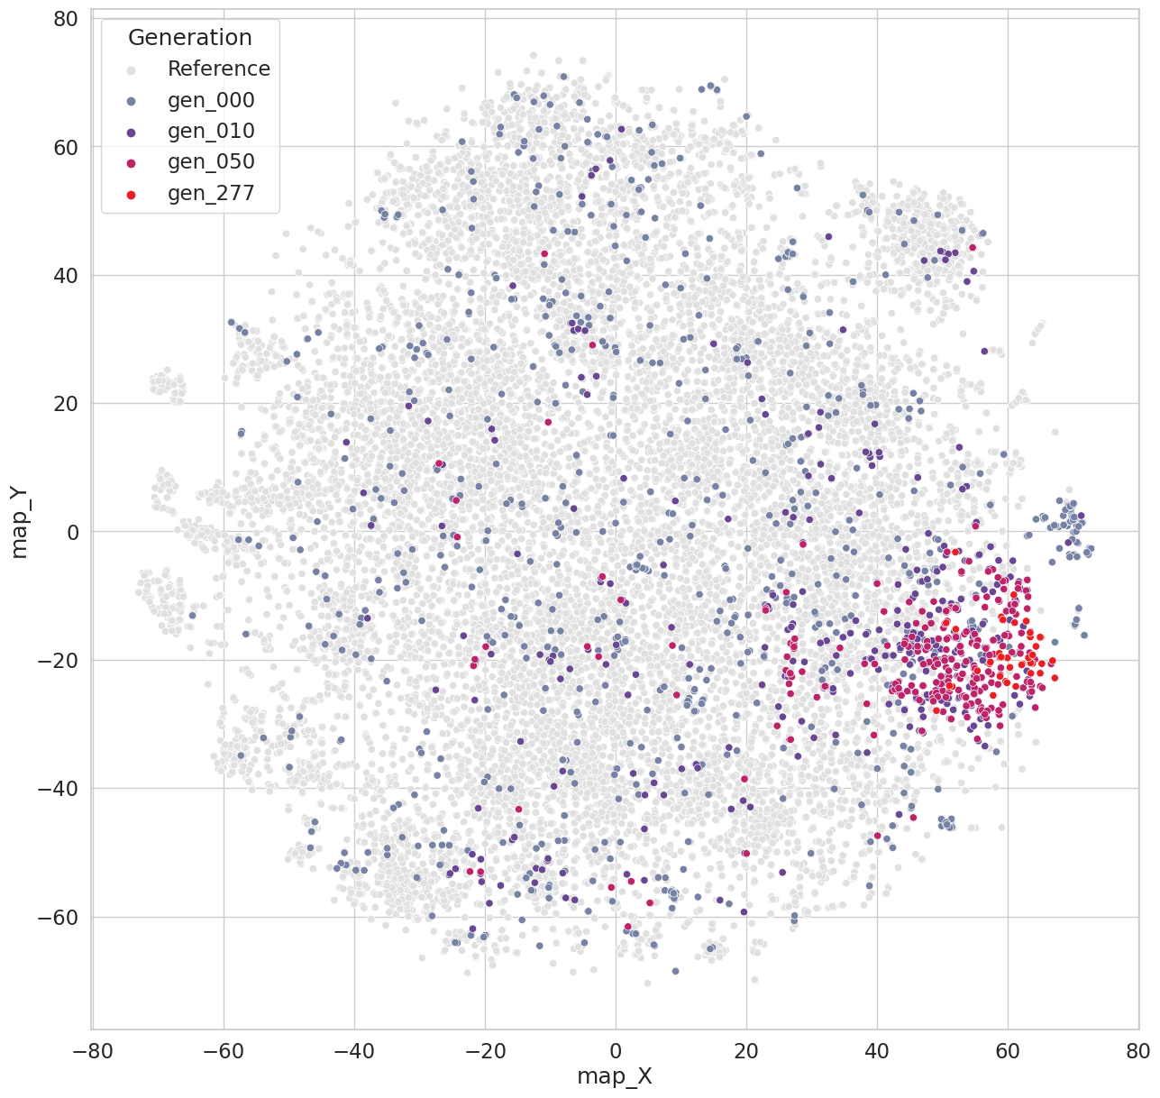
Cost and individual parameter predictions converge toward desired outcomes over time
On-target 1
pIC50
BBBp
logBB
cost

Slide 17
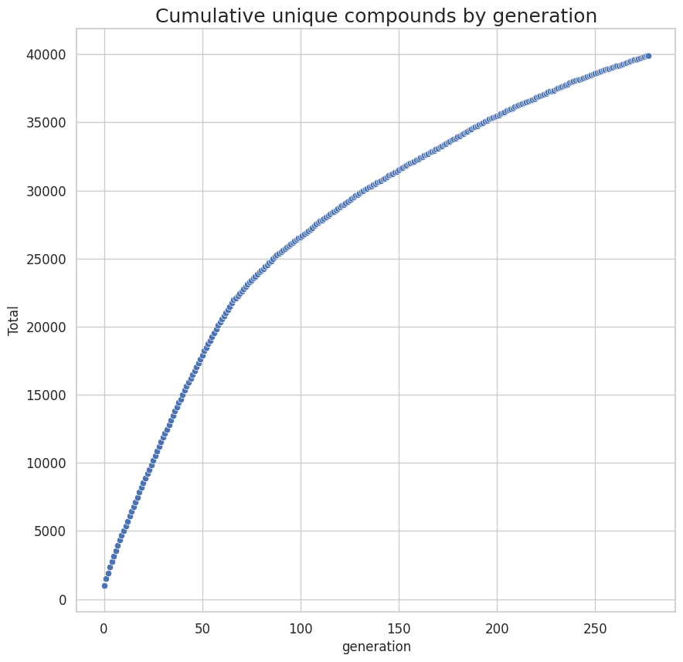
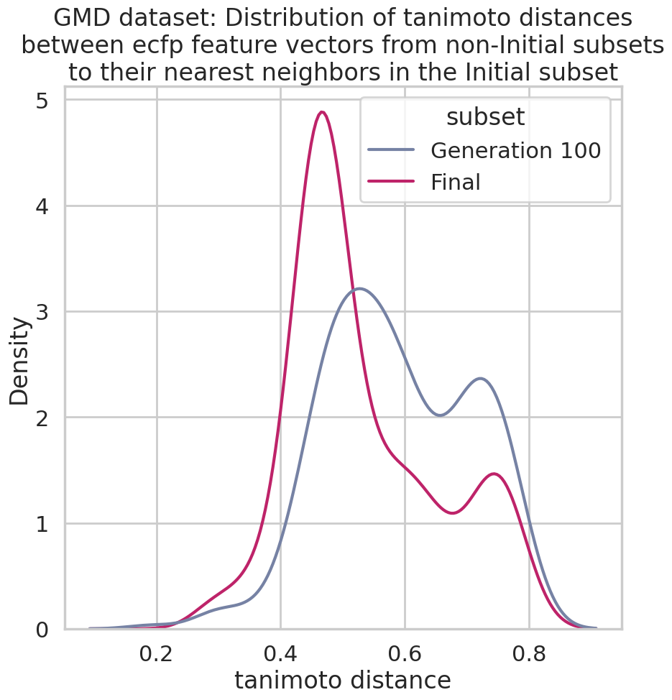
The GMD loop produces novel compounds

Slide 18
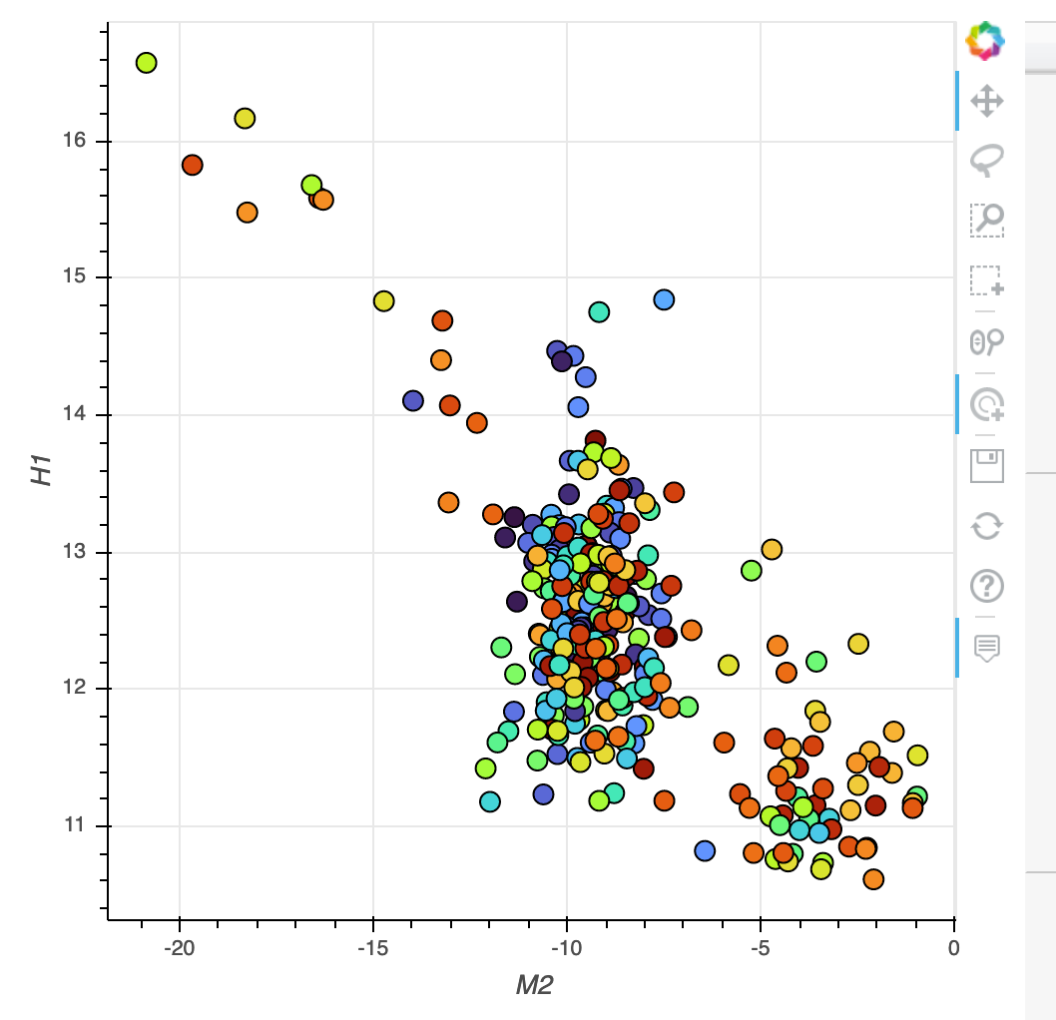
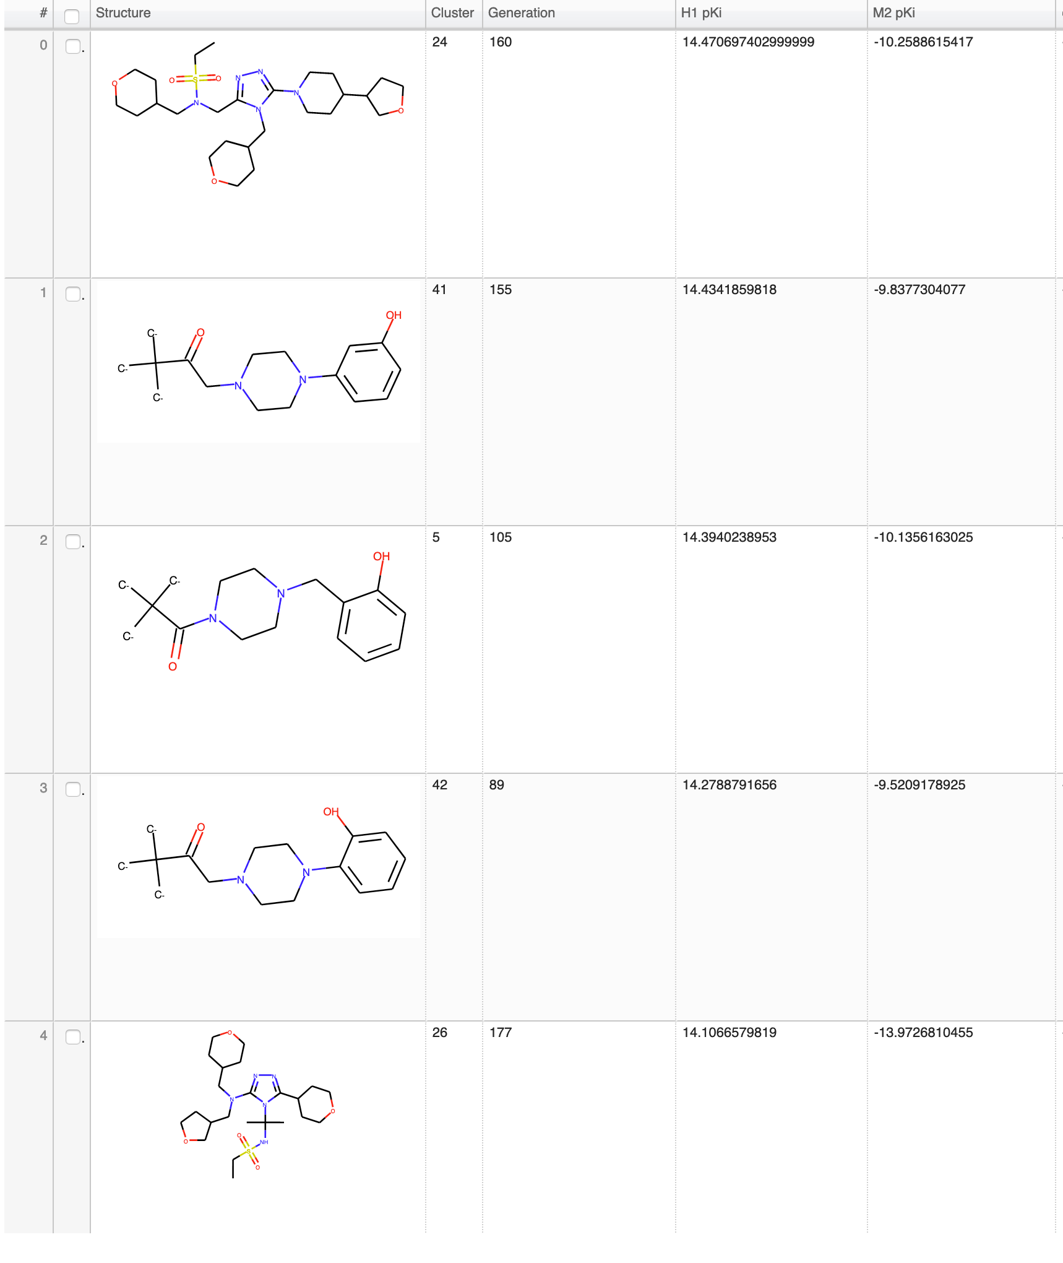
The GMD loop can propose compounds far outside the domain of applicability
On-target 1 pKi
(Highest in training data = 10.3)
Off-target 2 pKi (lowest in training data: 3.7)
Slides courtesy of Kevin McLoughlin
Notes:
Compounds produced by first GMD runs had weird structures and crazy predicted pKi’s for H1 and M2.
Optimizing for H1 selectivity led to compounds far outside the applicability domain of the models. We needed to add some AD constraints to the GMD optimization.

Slide 19
Z-score based applicability domain index
Use Euclidean distances between feature vectors of compounds.
Fit a normal distribution on the mean distances of all training set points to their K nearest neighbors.
Calculate the Z-score of the mean distance of the predicted point to its K nearest neighbors in the training set, rectify the negative Z-scores.
Use the Z score as an additional parameter in the cost function
Mathea, M., Klingspohn, W., & Baumann, K. (2016). Chemoinformatic classification methods and their applicability domain. Molecular Informatics, 35(5), 160-180.
Slides courtesy of Kevin McLoughlin

Slide 20
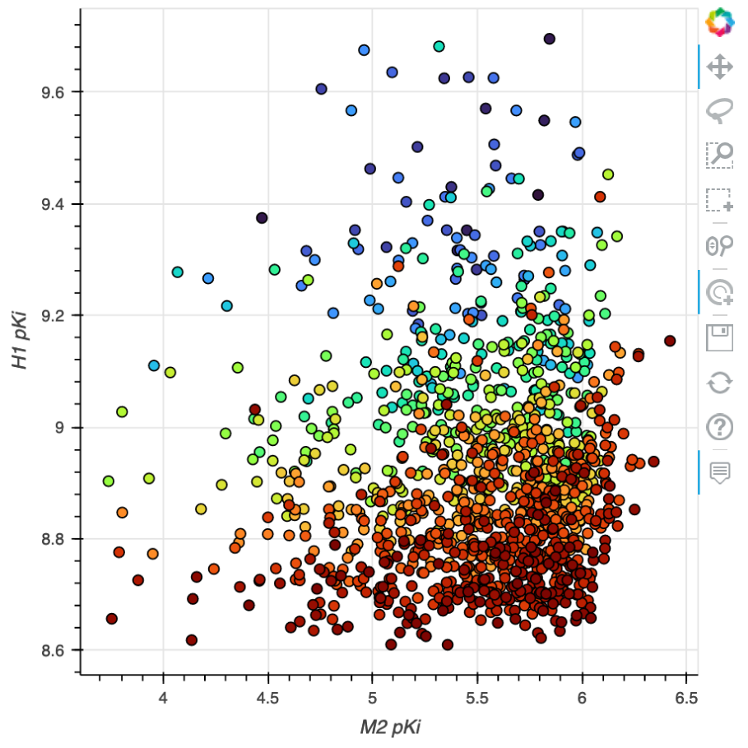
GMD loop: Generated structures with and without ADI
On-target 1 pKi
(Highest in training data = 10.3)
On-target 1 pKi
Off-target 2 pKi (lowest in training data: 3.7)
Off-target 2 pKi
Slides courtesy of Kevin McLoughlin

Slide 21
Conclusions
JT-VAE based generative models yield novel molecular entities with desired predicted properties
ADI example:
35/106 synthesized compounds achieved dose-response inhibition of target
8/35 achieved desired 100x selectivity profile
Constraining the GMD with an accessibility domain index can further refine the proposed compounds

Slide 22
Challenges in in silico drug design

Slide 23
Balancing experimental complexity, throughput and costs when generating new data
Throughput inversely correlates to experimental complexity & cost
But, ML algorithms are greedy
How can we improve property prediction models while keeping experimental costs low and throughput high?
Throughput
PAMPA-BBB
Cell-based permeability
Microfluidic systems, iPS, 3D culture
In vivo perfusion
Complexity, accuracy
Notes:
How can we use the data we already have in the most thoughtful ways

Slide 24
Application of ATOM platform for prediction of blood-brain barrier penetrance

Slide 25
Property Prediction Pipeline
Efficacy
Safety
Working
Compound
Library
PK
Developability
Design Criteria
Generative Molecular Design
Prediction & Design Loop
proposes new molecules with optimized properties
Retrain property prediction models
Active learning
decides if/when a simulation or experiment is needed to improve or validate models
MD, docking, PBPK, PD/mechanistic models
Simulation Loop
Human-
Relevant
Assays
Chemistry Design & Synthesis
Experimental Loop
Notes:
We frame in silico drug design as a multi parameter optimization problem paired with active learning to improve and validate our predictors

Slide 26
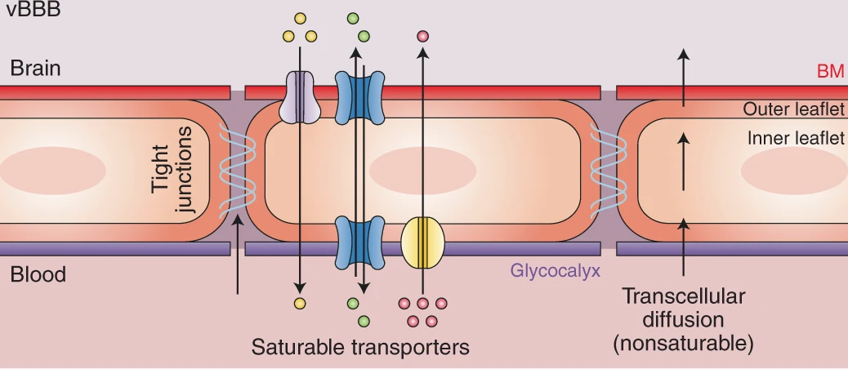
Target efficacy
In vitro BBB membrane permeability
In vitro efflux transporters
In vivo BBB penetrance
Target in brain
Banks, W.A., Reed, M.J., Logsdon, A.F. et al. Healthy aging and the blood–brain barrier. Nat Aging 1, 243–254 (2021). https://doi.org/10.1038/s43587-021-00043-5

Slide 27
AMPL: the ATOM Modeling PipeLine
Data ingestion & curation
Molecular featurization
Model building & visualization
HP tuning & model tracker
HP visualization & model selection
Prediction & inference
General curation from ChEMBL, DTC, Excape. Best practices for bespoke curation of data.
Fingerprints, physicochemical descriptors, graph convolutional representations. Flexibility to add custom features. Random, scaffold and other splitting methods.
Random forests, XGBoost decision trees, neural networks. Fast implementation of new models from DeepChem (sklearn, tensorflow or pytorch).
SLURM based HPC system for parallelization of model training coupled with a custom database for model storage and lookup allows for massive HP searches.
General model performance evaluation & best practices for selecting models.
Generate predictions on new compounds with associated applicability domain analysis.
https://github.com/ATOMScience-org/AMPL
Notes:
Full suite of tools from curation & EDA to model building & inference
Built in python on top of & extends deepchem
We work hard to integrate available deepchem models into our pipeline

Slide 28
QSAR modeling steps
Data ingestion and curation
Featurize with molecular descriptors:
Moe
Mordred
RDKit
ECFP
GraphConv
Train/ val/ test split
Scaffold
Model
Random forest
Neural network
XGBoost
Classification
Regression
Multitask
Predict
Yes/No inhibition label
pIC50 value
Curated Smiles
COc1ccc2[nH]cc(CCNC(C)=O)c2c1
NC(=O)c1cnccn1
Clc1cccc(N2CCNCC2)c1
Nc1c2c(nc3ccccc13)CCCC2
CC(=O)Nc1ccc(O)cc1
CC(=O)Nc1nnc(S(N)(=O)=O)s1
CCCSc1ccc2nc(NC(=O)OC)[nH]c2c1
Uncertainty quantification
Applicability domain

Slide 29
Brute force hyperparameter tuning via grid search
Scaffold split
Fingerprint split
Mordred
MOE
RDKit
ECFP
GraphConv
Neural Network (single)
Neural Network (multitask)
Random Forest
XGBoost
Number of estimators
Tree depth
Max features per node
Gamma
Learning rate
Number of layers
Layer sizes
Learning rate
Dropouts

Slide 30
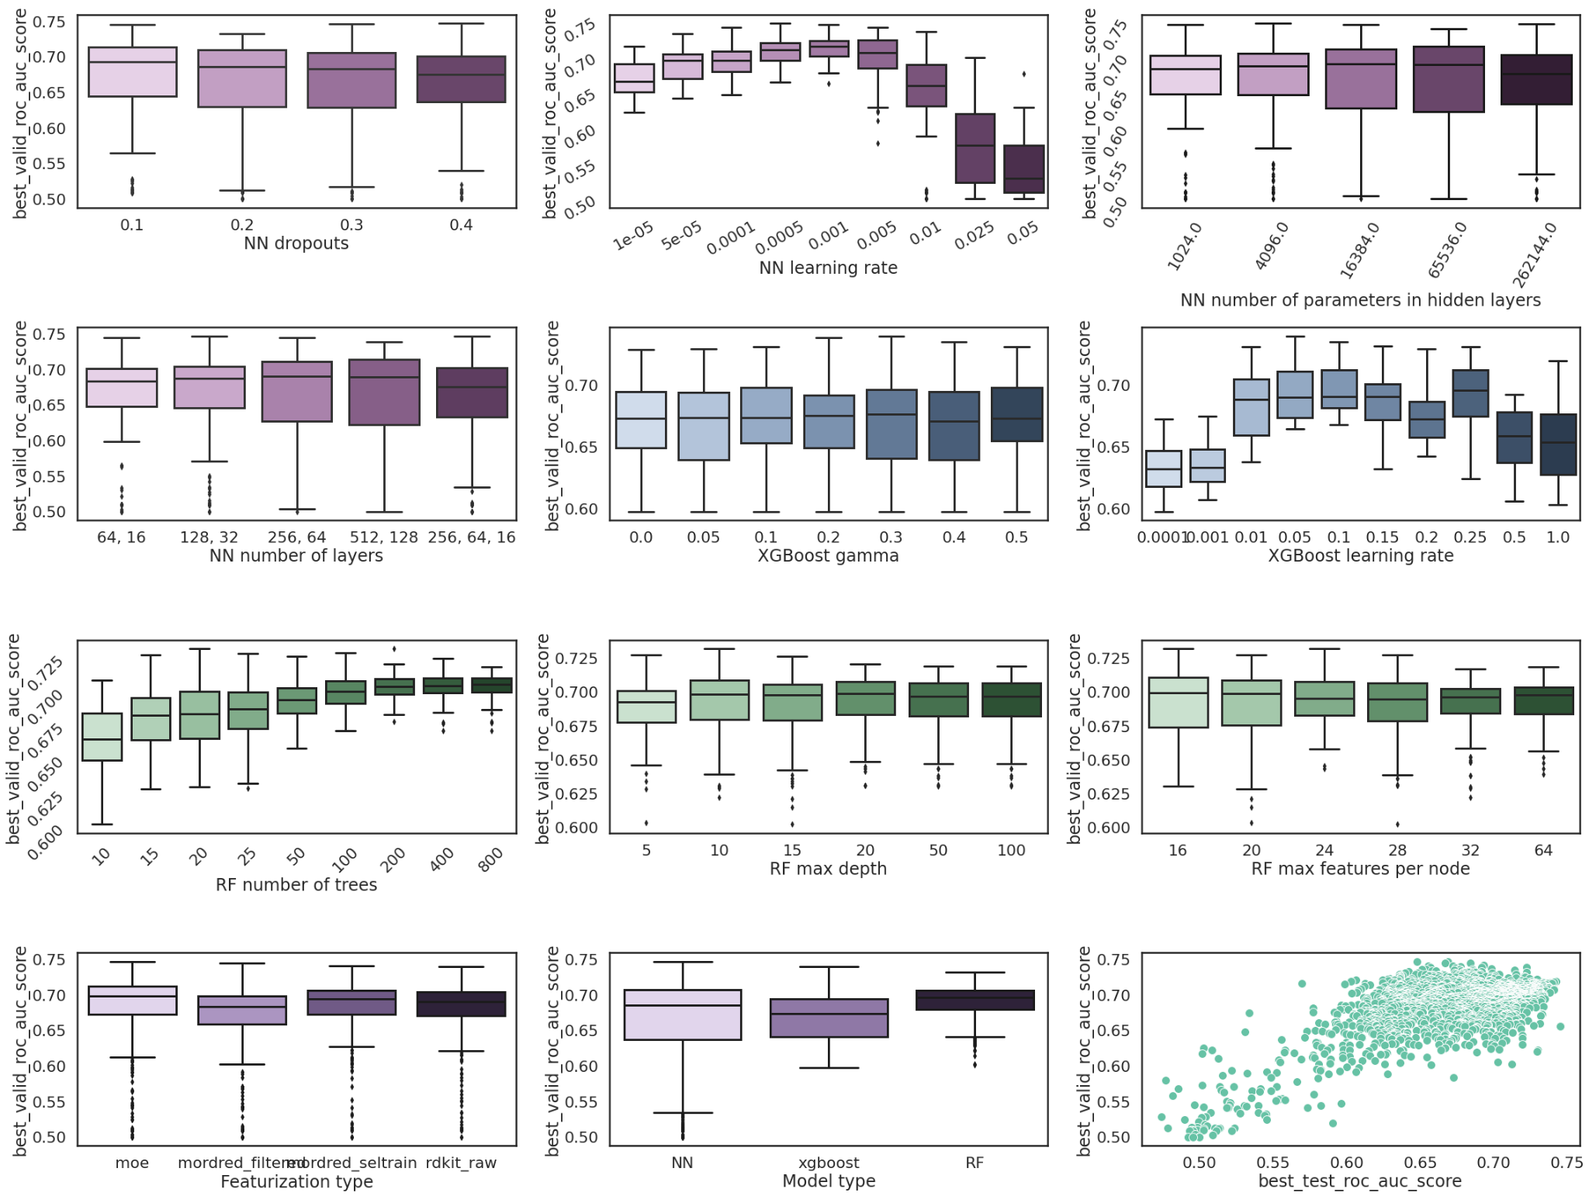
Visualizing results from hyperparameter searches

Slide 31
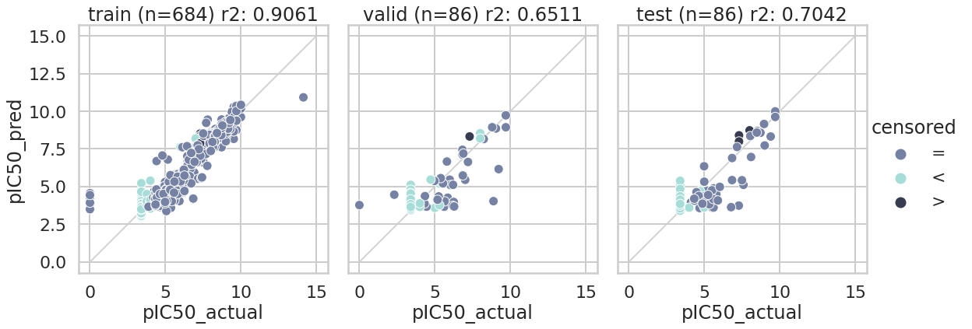
Visualizing performance of selected best models (regression)

Slide 32
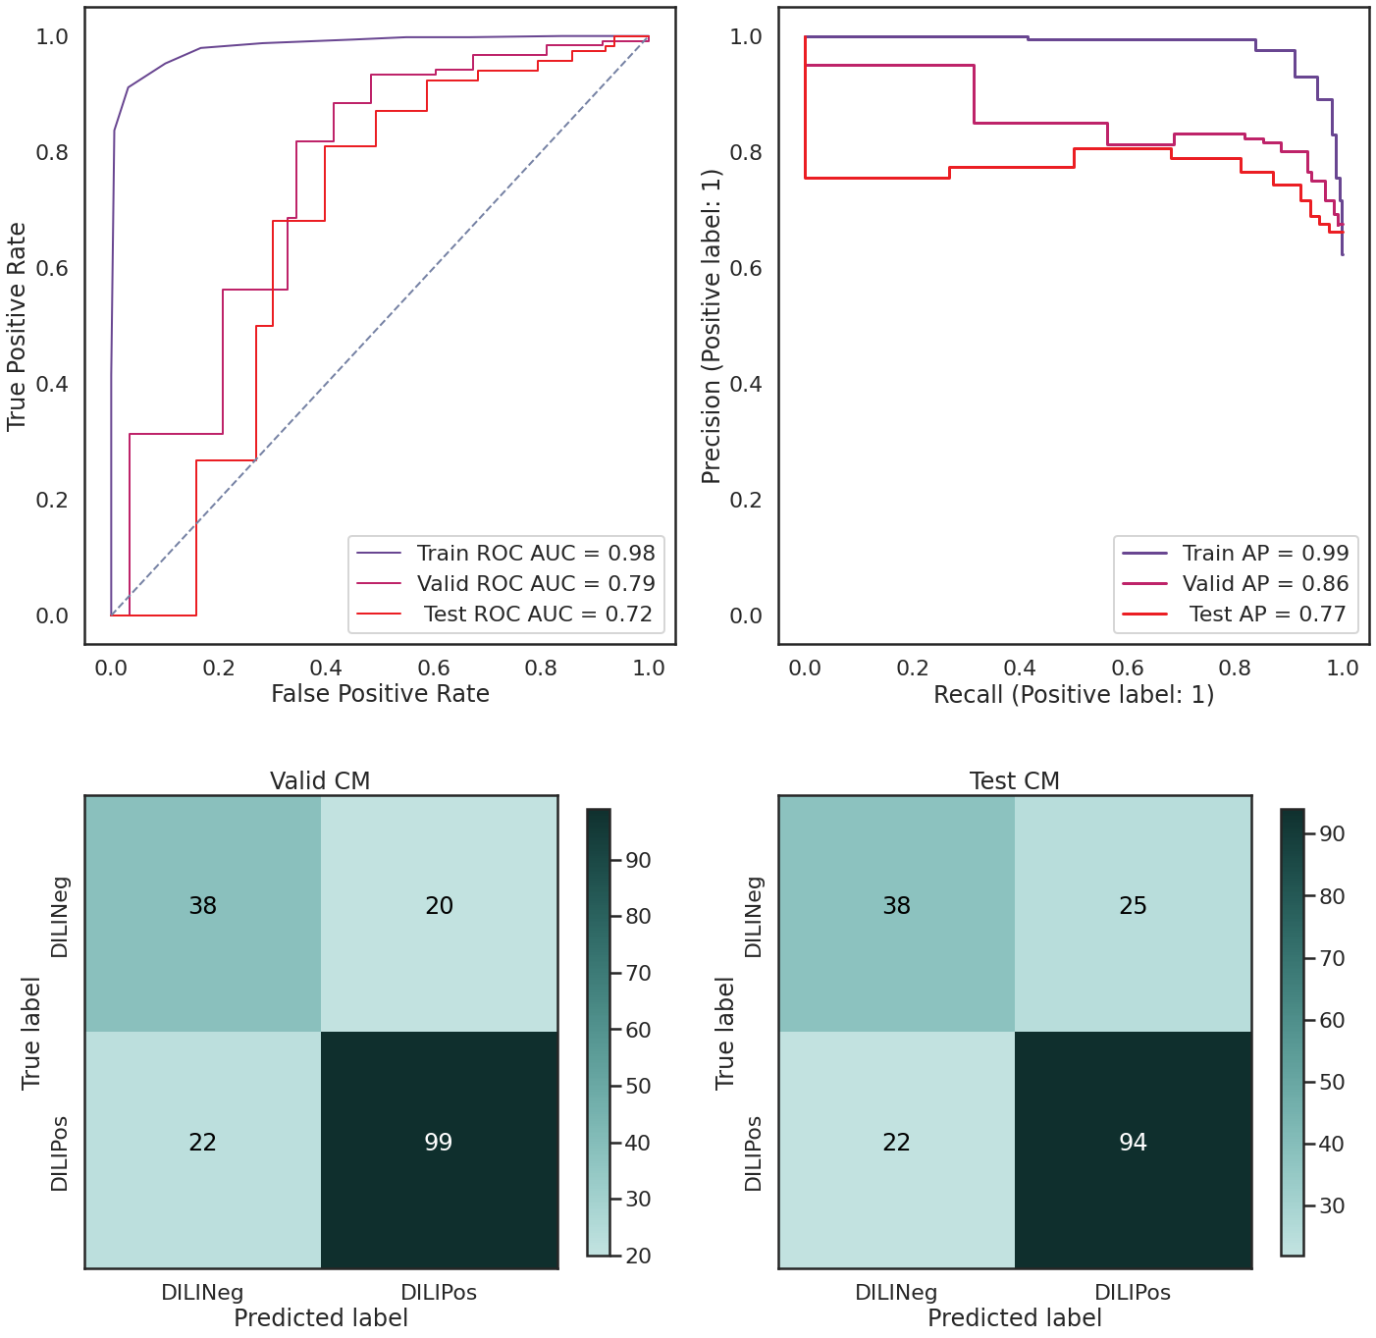
Visualizing performance of selected best models (classification)
ROC Curve:
TPR/Sensitivity/Recall
vs
FPR/(1-specificity)/
Prob. of false alarm
Confusion matrix:
TN/FP
FN/TP
Precision/Recall curve:
Precision = TP/TP+FP
Recall = TP/TP+FN

Slide 33
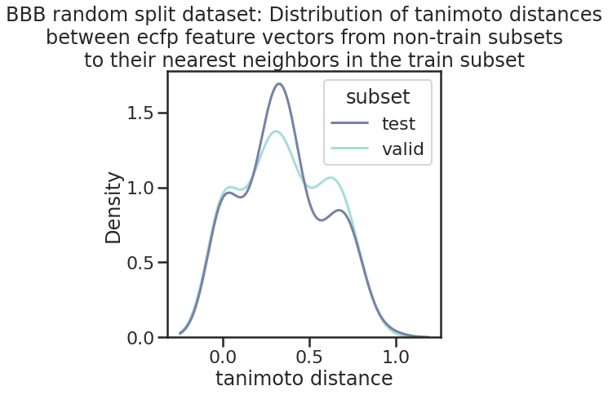
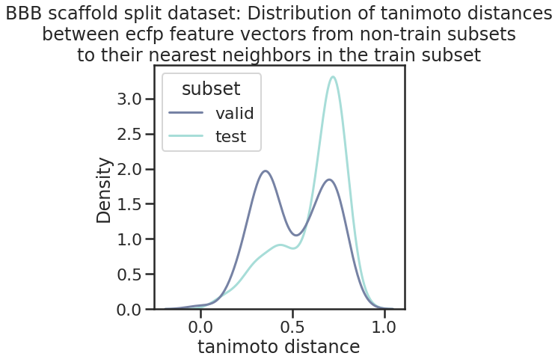
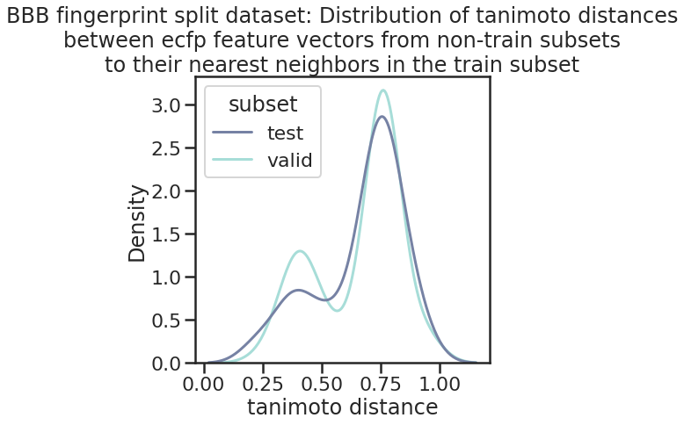
Training models for generalizability using challenging dataset splits
Random
Scaffold
Fingerprint
Target | # Cmpds | Split | Model Info | Valid R² | Test R²
In vivo BBB penetrance | 1181 | Scaffold | NN w/ RDKit | 0.63 | -0.17
 |  | Fingerprint | NN w/ RDKit | 0.60 | 0.28
Notes:
As a baseline we generally choose scaffold splitting and then further explore fingerprint splits

Slide 34
Fingerprint splits reveal model weaknesses
Target | # Cmpds | Split | Model Info | Valid R² | Test R²
In vitro PAMPA-BBB | 1461 | Scaffold | NN w/ Mordred | 0.38 | 0.26
 |  | Fingerprint | NN w/ Mordred | 0.25 | -0.25
In vitro P-gp efflux | 3350 | Scaffold | NN w/ RDKit | 0.46 | 0.40
 |  | Fingerprint | XGBoost w/ RDKit | 0.24 | 0.18
In vitro BCRP efflux | 223 | Scaffold | NN w/ GraphConv | 0.35 | -0.55
 |  | Fingerprint | NN w/ MOE | 0.34 | 0.17

Slide 35
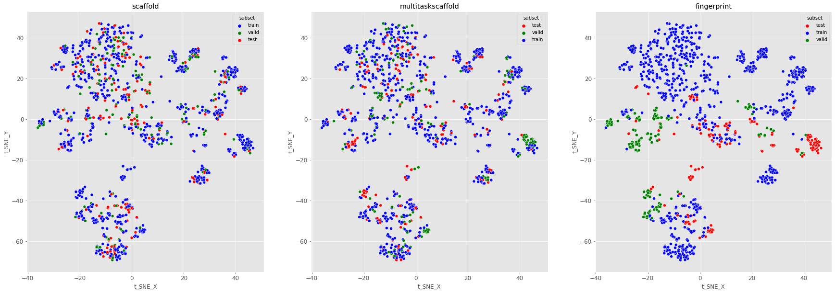
Visualizing the effects of different splitters on data partitioning

Slide 36
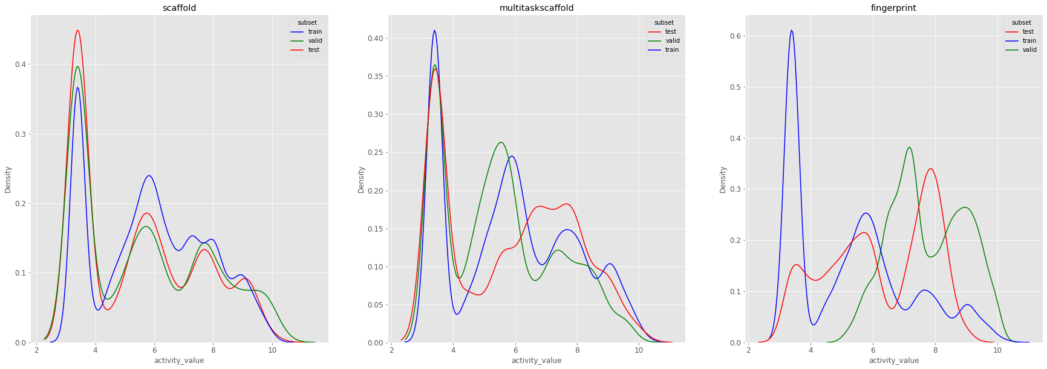
Visualizing the effects of different splitters on data partitioning

Slide 37
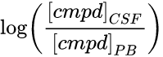
‘QBAR’ modeling combines chemical and biological features
In vivo BBB penetrance defined by logBB:
QSAR: use chemical descriptors alone to predict logBB
Model building and hyperparameter optimization via grid search
Calculate molecular descriptor features for 1181 compounds with logBB data
Compare final model performance
‘QBAR’: add true & predicted PAMPA & transporter assay data as bio features
Hypothesis: biological data from cheaper, higher throughput experiments as inputs will improve prediction of complex in vivo phenotypes over chemical descriptors alone
Notes:
Still face the problem of validating new compounds or generating more data for this in vivo endpoint

Slide 38
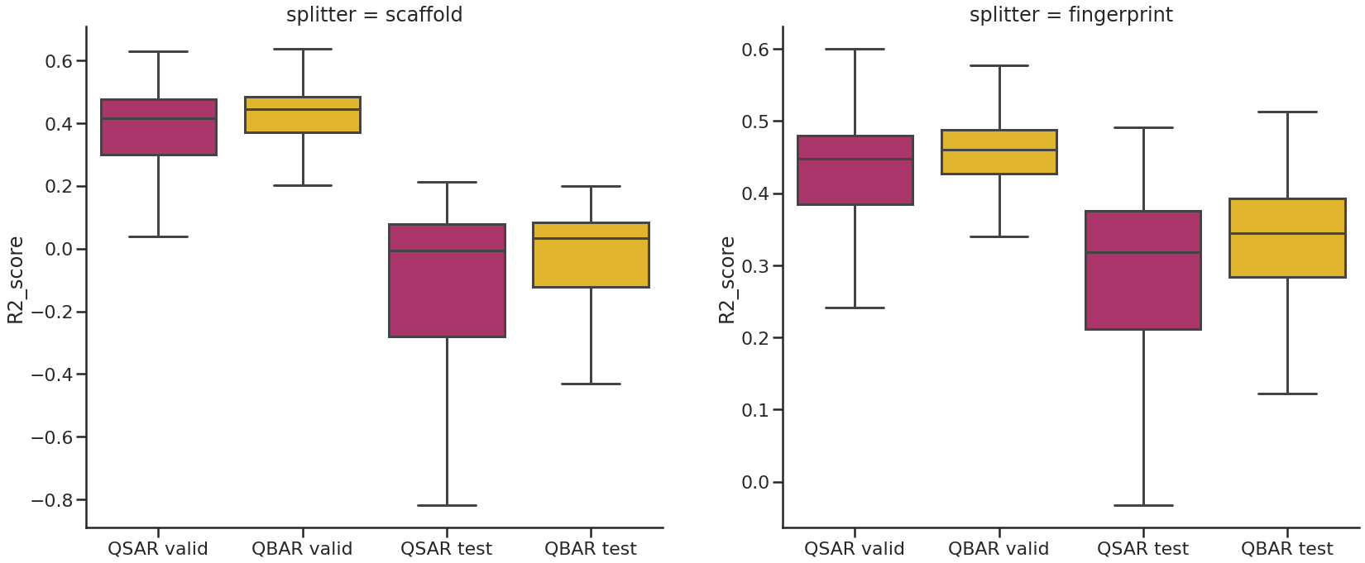
Fingerprint splits and QBAR modeling improve generalization of logBB predictions
*
**
n.s.
***
QSAR
QBAR
Wilcoxon Signed-Rank test for significance
Effect sizes (ΔMAD): Scaff valid = 0.28; FP valid = 0.13; FP test = 0.25

Slide 39
Best BBBp model performance
Best model | Valid R² | Test R² | Valid RMSE | Test RMSE | Valid MAE | Test MAE
FP-QBAR | 0.62 | 0.42 | 0.52 | 0.51 | 0.38 | 0.39
FP-QSAR | 0.60 | 0.28 | 0.53 | 0.57 | 0.39 | 0.43

Slide 40
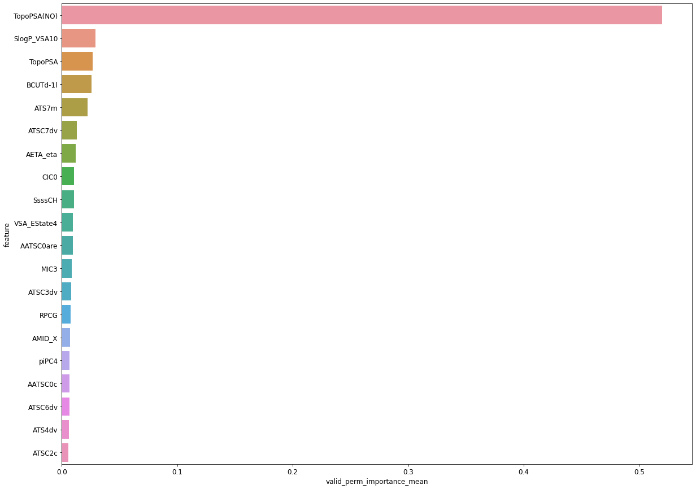
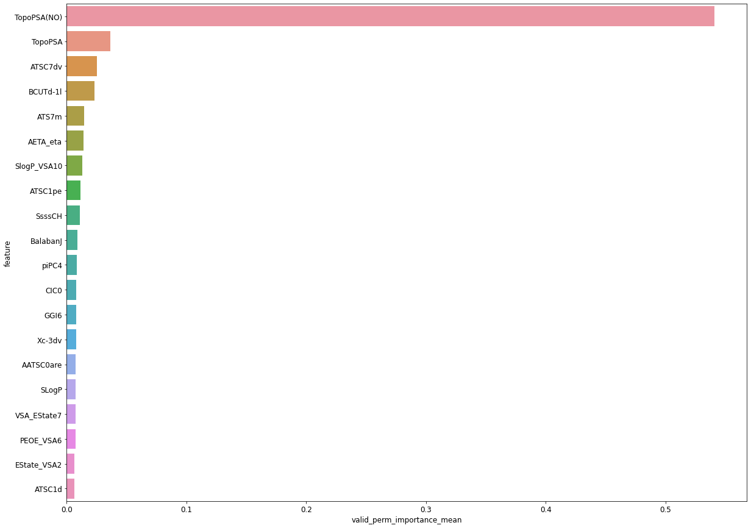
QSAR QBAR: add PGP, BCRP, PAMPA
Feat Rankings | PGP | BCRP | PAMPA
Train | 306 | 172 | 27
Valid | 212 | 273 | 1543
Test | 93 | 124 | 1519
Fingerprint models

Slide 41
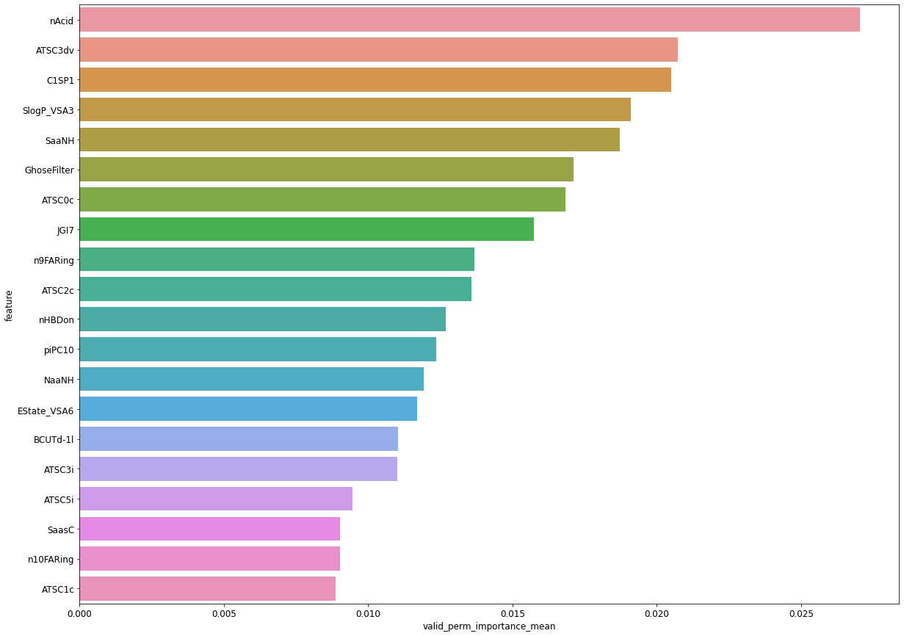
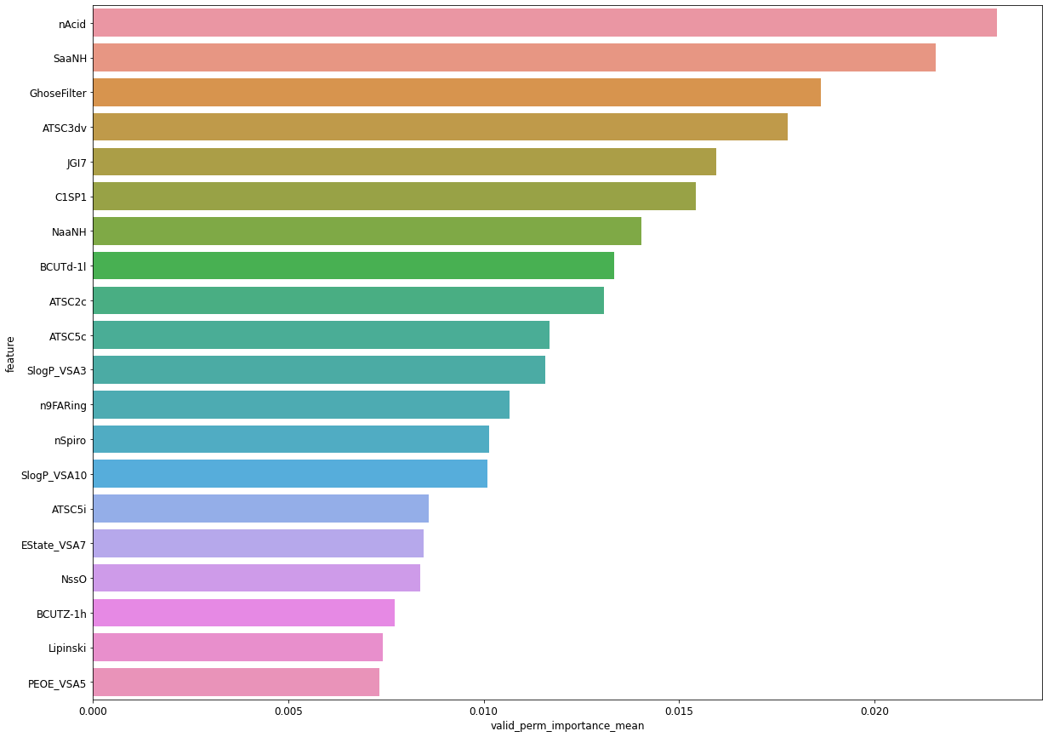
QSAR QBAR: add PGP, BCRP, PAMPA
Feat Rankings | PGP | BCRP | PAMPA
Train | 614 | 31 | 94
Valid | 1349 | 42 | 196
Test | 1327 | 8 | 1400
Scaffold models

Slide 42
Conclusions
AMPL is an open source, full suite of QSAR modeling tools (https://github.com/ATOMScience-org/AMPL)
Fingerprint splitting is the most challenging split but can provide increased generalizability
Including predictions or real data from simpler, high throughput experiments can improve the accuracy and generalizability when predicting outcomes from complex biological processes like blood brain barrier penetrance
Feature importance analysis shows large differences between FP/Scaffold, but hard to interpret the value of adding bio features for train/valid/test performance

Slide 43
Acknowledgements
ATOM Tech Team
Jonathan Allen
Kevin McLoughlin
Jeff Mast
Amanda Paulson
Stewart He
Hiran Ranganathan
Ya Ju Fan
Titli Sarkar
Pinyi Lu
Sean Black
Jim Brase
Former members:
Da Shi
FNL Team
Eric Stahlberg
Dwight Nissley
Naomi Ohashi
Dominic Esposito
Simon Messing
UCSF Team
Michelle Arkin
Alan Ashworth
Jeff Neitz
Morgan Diolati
Jez Revalde
Jill Hoffstadt
Yagmur Doruk Polcyn
Manasi Jogalekar
Prasanna Kandel

